Slide 1
USPS-R
Fiscal Year-End Closing Procedures
2025

Slide 2
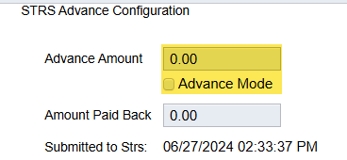
Pre-Closing Procedures
Process any life insurance premium payments
Run STRS Advance Reports
Verify STRS Advance Configuration amount is zero and Advance Mode is unchecked from previous fiscal year

Slide 3
Pre-Closing Procedures
Cost of Life Insurance Over $50,000
  For those employees retiring as of June 30 the life insurance amount should be processed through Payroll Current or Future (or as an Adjustment record)
  Reference IRS Publication 15-B
http://www.irs.gov/pub/irs-pdf/p15b.pdf (page 13- 15)

Slide 4
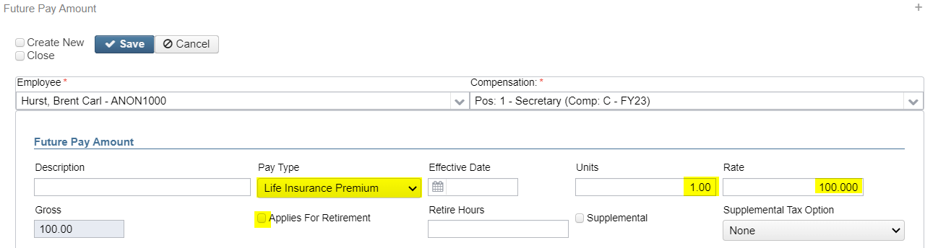
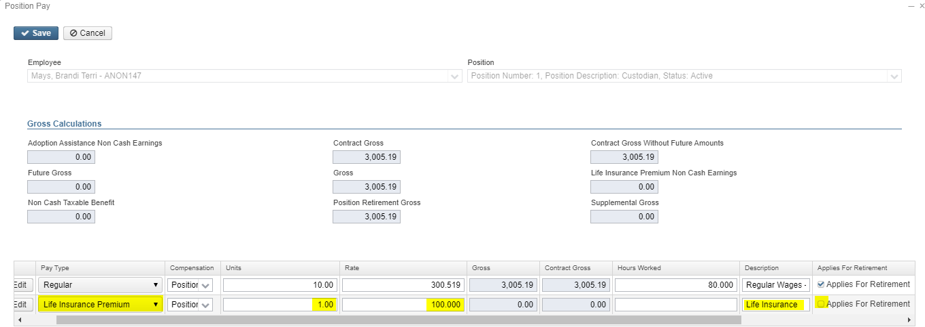
Pre-Closing Procedures
Payroll Payments - Future
Payroll Payments - Current

Slide 5
Pre-Closing Procedures
If processed as “Life Insurance Premium Pay Type”
  Added to Total and Applicable Gross even though no tax is withheld (for W2 purposes)
  Federal, State, & OSDI taxes are not withheld
  Medicare & FICA are withheld
  City tax is based on the Core > Payroll Item Configuration > Tax Non Cash Earn checkbox

Slide 6
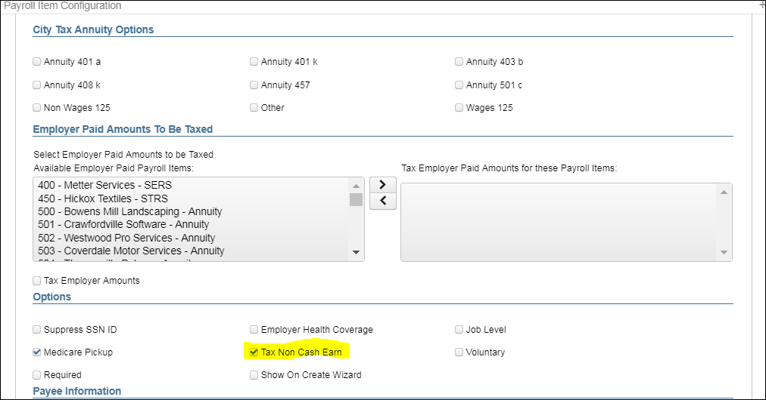
Pre-Closing Procedures

Slide 7
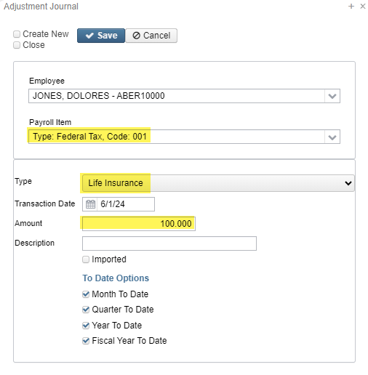
Pre-Closing Procedures
Life Insurance Premium Using Core > Adjustments:
If the Life Insurance Premium Pay Type was not posted prior to the employee’s final pay, then a Core > Adjustment to the 001 (Federal) Payroll Item using the Life Insurance Type needs to be posted.

Slide 8
Pre-Closing Procedures
  continued
  W2 Report will add the amount to the Total and Applicable Gross to the Federal, State, OSDI, and Medicare (No Adjustments needed)
  City is based on the Core > Payroll Item Configuration > Tax Non Cash Earn checkbox
  If the Medicare withholding was paid by the employee and/or employer, Adjustments will need to be created

Slide 9
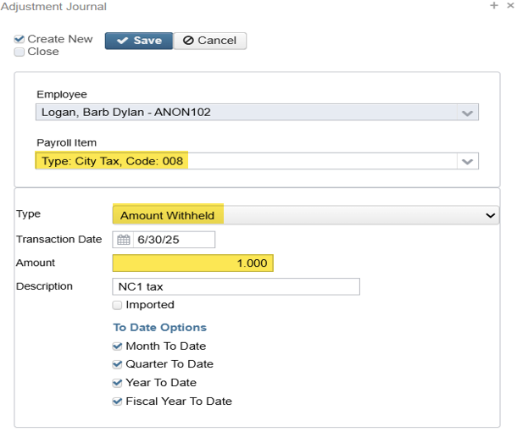
Pre-Closing Procedures
  City Payroll Items:
  The city Total Gross and Taxable Gross is only adjusted when the Core > Payroll Item Configuration > “Tax Non-Cash Earn” is checked. If any Core > Adjustments are entered involving non-cash earnings, the city tax will need to be calculated, the appropriate adjustments entered, and the appropriate payments processed
  Example: $100 x 1% = $1.00

Slide 10
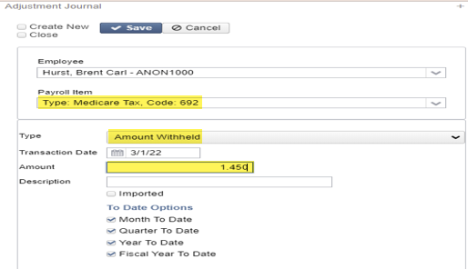
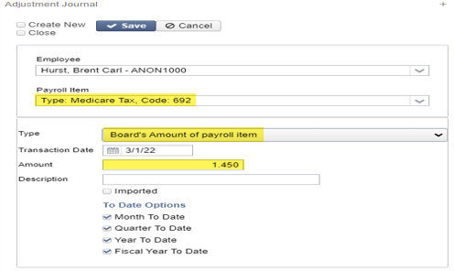
Pre-Closing Procedures
Medicare Paid by Employee – Employee and Employer Paid Adjustments:
Employee Adjustment
Employer Adjustment

Slide 11
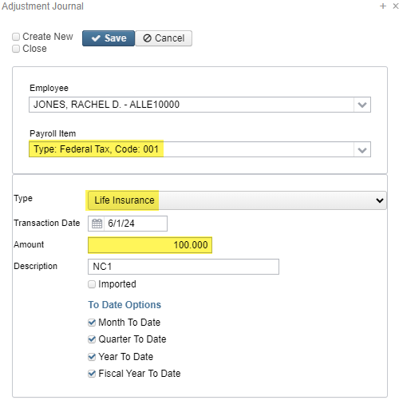
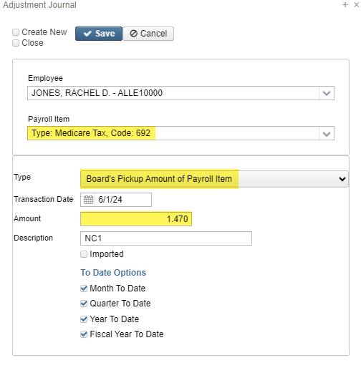
Pre-Closing Procedures
Medicare Pickup – Employer Paid Adjustments:
Example:
$100.00 Life Insurance Cost / 98.55% = $101.47 Applicable Gross
$101.47 Applicable Gross x 2.9% (1.45% x 2) = $2.94 Board Payment
$1.47 Is the amount used for the Adjustment of the Board Pickup Amount of the Payroll Item. This will update both Medicare Pickup for $1.47 and Medicare for $1.47 on the Employee's W2.

Slide 12
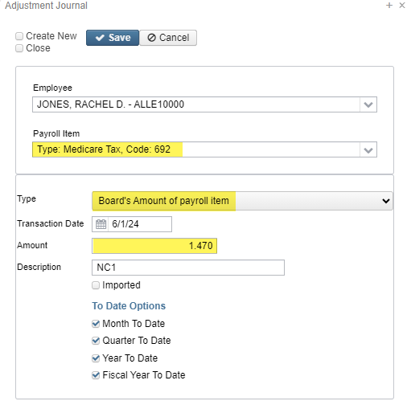
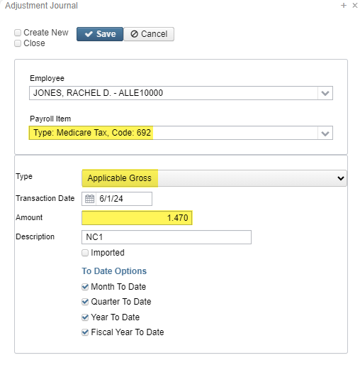
Pre-Closing Procedures
Medicare Pickup Adjustment ctd:
Example:
$101.47 Applicable Gross - $100 Life Insurance Cost = $1.47 Applicable Gross Adjustment
$1.47 is the adjustment amount for Board Pickup Amount of the Payroll Item, which updates both Medicare Pickup & Medicare for $1.47 each on the employee’s W2 (example on last side)
$1.47 is the adjustment amount for Board’s Amount of Payroll Item, which updates the 941 Quarter Report ‘QTD Employer’s Medicare Contribution’
$1.47 is the adjustment amount for Applicable Gross, which updates the employee’s W2 Taxable Gross for Medicare

Slide 13
Pre-Closing Procedures
NOTE: Life Insurance Premium amounts are not included in the Total Gross charged to USAS
The following reports provide special totals to assist in balance:
Pay Report under “Pay Type Totals”
Pay Amount Summary Report under “Other Pay” and “All Pay”
Quarter Report under “Totals Summary”

Slide 14
Pre-Closing Procedures
Run STRSAD Reports now to avoid issues after the final pay in June is processed
  Go to Reports > STRS Reporting > STRS Advance
    Non-Advance Positions Report – Report of positions not advancing and also includes days in contract, days worked as of June 30, contract obligation, and amount due
    Advanced Positions Report – Report of all positions advancing and also includes service credit, contract amount due, advanced amount, and rehired retiree
    Advance Fiscal Year to Date Report – Report of all STRS employees and also includes service credit, STRS days, earnings, STRS employee amount, advance amount, and rehired retiree

Slide 15
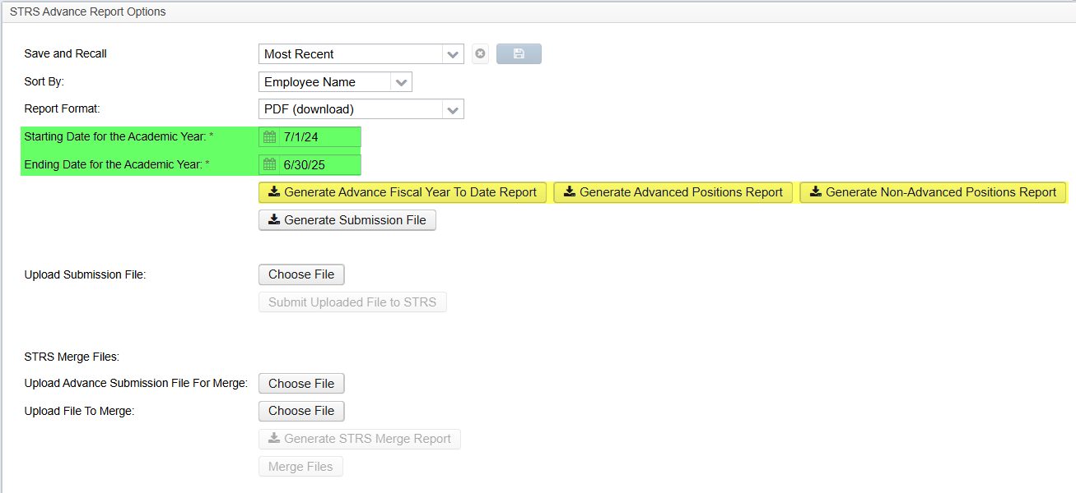
Pre-Closing Procedures

Slide 16
Month-End Closing

Slide 17
Month-End Closing
Balance payroll clearance account
Process any monthly outstanding payables
Verify all outstanding payables
Run STRS Monthly (Optional)
Run SERS Monthly (Optional)
Run CENSUS Report (Optional)
Run AFFORD (Affordable Care Act) Report (Optional)
Process benefit accruals
Verify if any adjustments need to made for weeks, days, or hours for ODJFS, SERS, and STRS

Slide 18
Quarter-End Closing

Slide 19
Quarter-End Closing
Balance Quarter Report
Balance W2 Report
Verify all outstanding payables
Balance all board paid payroll items
Complete and file all quarter submission forms
Balance and submit ODJFS
Create SERS Liability Report to be used later by the auditors
  Wage Obligation by Employee report only for SERS employees
Run the SERS Surcharge Report
  https://www.ohsers.org/employers/annual-processes/surcharge/

Slide 20
Fiscal Year-End Closing

Slide 21
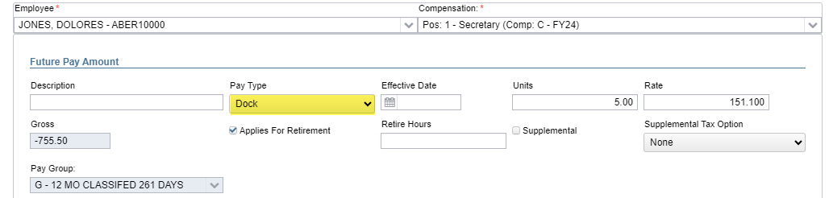
STRS Advance
After all June pays are completed and before processing the STRS Advance, consider:
  Early contract payoffs – calculate and update Compensation screen
  Any docks over the summer
    Enter the dock information in Payroll Payments - Future. After the advance has been processed, the dock should be deleted from Future and processed at the appropriate time

Slide 22
STRS Advance
Run and balance all STRS reports
Go to Reports > STRS Reporting > STRS Advance
  Click on Generate Advance Fiscal Year To Date Report
  Click on Generate Advance Positions Report
  Click on Generate Non-Advanced Positions Report

Slide 23
STRS Advance
Advance Fiscal Year to Date Report – Lists all employees subject to STRS withholding for the fiscal year
Employee must have a Position with retirement system set to STRS
Employee must have earnings in the fiscal year. Earnings are a sum of 3 things:
  For an advancing compensation, accrued wages will be added to earnings (accrued wages = contract obligation – amount paid – amount docked)
  Employee adjustments with type Total Gross and Payroll Item Code for 591 and/or 691 with a Transaction Date within the fiscal year
  Applicable Gross of historical STRS pay items paid to the employee on payrolls that are not imported from classic and have a Pay Date within the fiscal year
Employee must have a Contract Compensation with a date range that the falls within the current date AND the compensation pays paid is not equal to pays in contract or the compensation has been paid in the fiscal year
  OR Employee must have a non contract compensation with a date range that overlaps the fiscal year.
  Note: Having a Compensation Stop Date will prevent a compensation from advancing if that stop date falls within the academic date range. (Will show earnings on the FYTD report (compensation obligation - compensation amount paid - compensation amount docked)

Slide 24
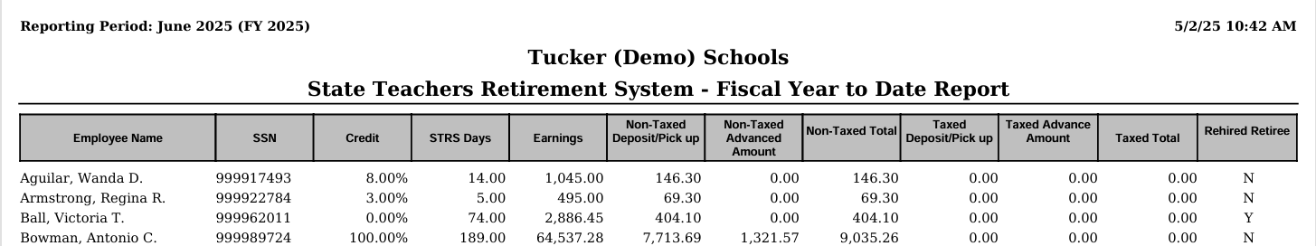
STRS Advance
Advance Fiscal Year to Date Report ctd.

Slide 25
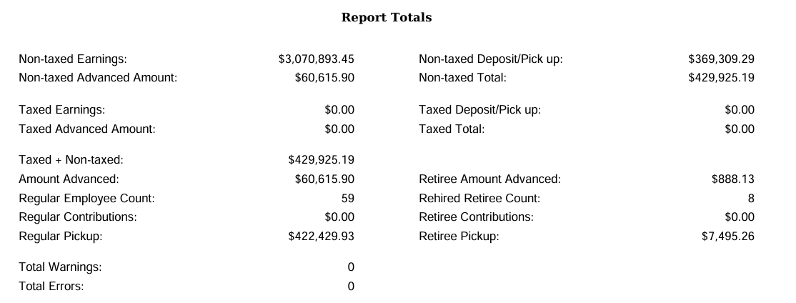
STRS Advance
Advance Fiscal Year to Date Report ctd.

Slide 26

STRS Advance
Advance Fiscal Year to Date Report ctd.
  Verify Service Credit
    Employees with 120 or more days receive 100% credit
    Employees with less than 120 days receive credit based on STRS decision tree
    Employees flagged as part-time receive service credit based on STRS decision tree
      Payroll Item > 450 > Full of Part Time field equals Part Time
      (Please contact STRS with questions regarding full or part time status.)

Slide 27
STRS Advance
Advance Fiscal Year to Date Report ctd.
  Balance Report

Slide 28
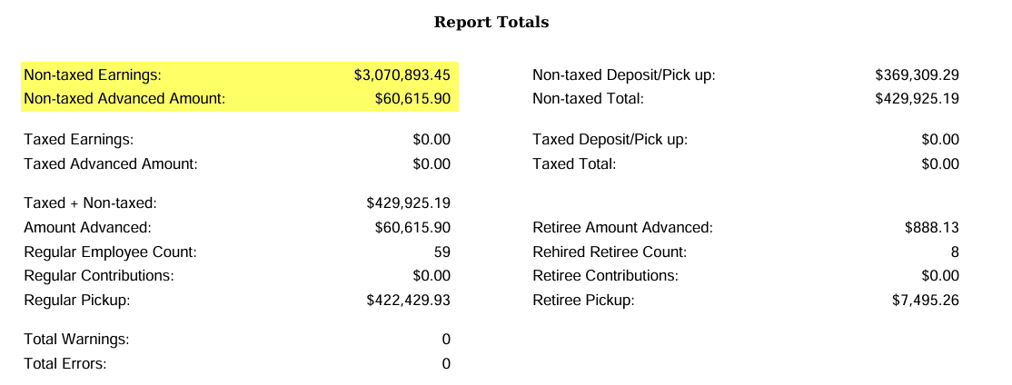
STRS Advance
Advance Fiscal Year to Date Report ctd.
  Balance Report ctd.
Non-taxed Earnings – FYTD gross amounts from the 450 Payroll Items + Accrued Wages.
Non-taxed Advanced Amount –
Retirement amount that will be withheld on summer pays on a per pay per compensation basis.

Slide 29
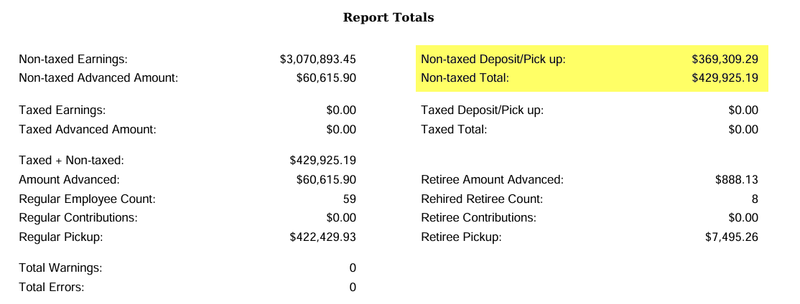
STRS Advance
Advance Fiscal Year to Date Report ctd.
  Balance Report ctd.
Non-taxed Deposit/Pick up =
Payments to STRS for the 591 and 691 for the FY
Non-taxed Total = Non-taxed Deposit/Pick up + Total Advance Amount

Slide 30
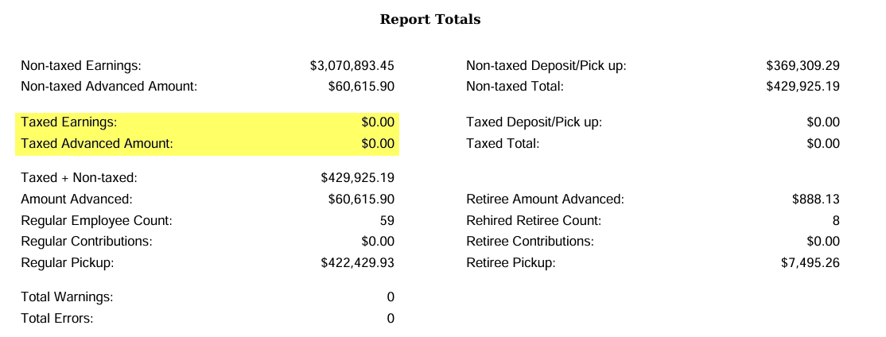
STRS Advance
Advance Fiscal Year to Date Report ctd.
  Balance Report ctd.
Taxed Earnings = Not common. Most STRS contributions are annuitized.
Taxed Advanced Amount = Not common. Most STRS contributions are annuitized

Slide 31
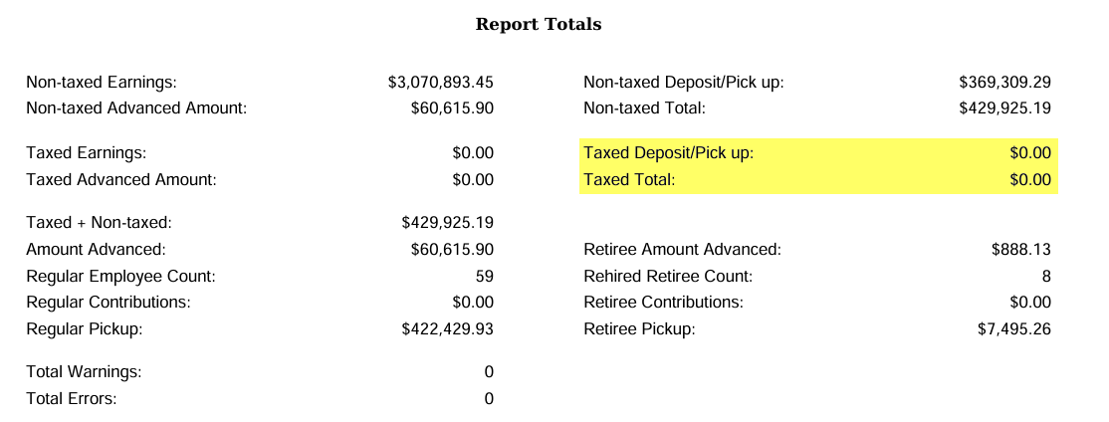
STRS Advance
Advance Fiscal Year to Date Report ctd.
  Balance Report ctd.
Taxed Deposit/Pick Up = Not Common. Most STRS
contributions are annuitized
Tax Total = Not Common. Most STRS
contributions are annuitized.

Slide 32
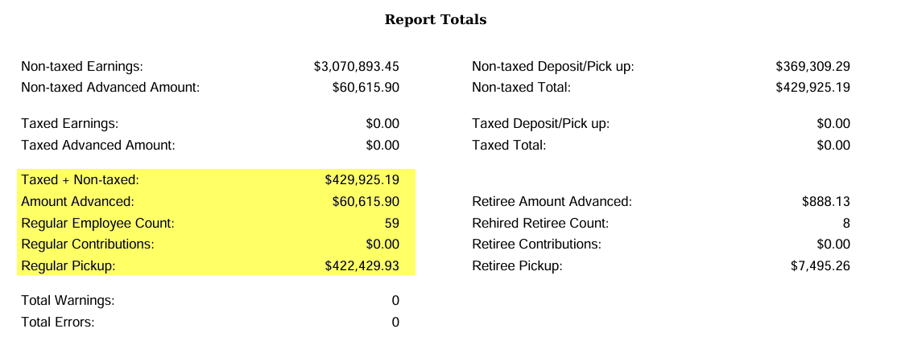
STRS Advance
Advance Fiscal Year to Date Report ctd.
  Balance Report ctd.
Taxed + Non-taxed = Amount paid to STRS during the fiscal year + Amount Advanced.
Amount Advanced = Retirement amount that will be withheld on summer pays on a per pay per compensation basis.
Regular Pickup = Taxed + Non-taxed – Retiree Pickup

Slide 33
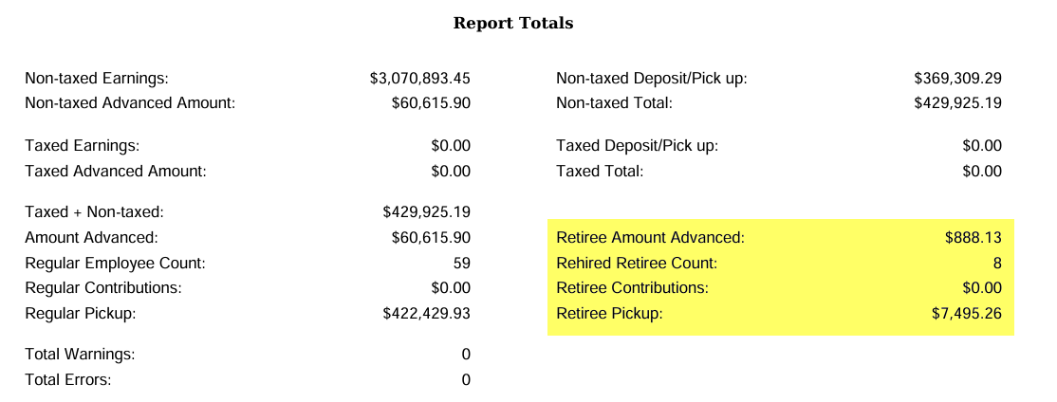
STRS Advance
Advance Fiscal Year to Date Report ctd.
  Balance Report ctd.
Retiree Amount Advance, Rehired Retiree Count, Retiree Contributions, and Retiree Pickup = Specific to those employee’s whose 450 Payroll Item>Rehired Retiree checkbox is checked.

Slide 34
STRS Advance
Advance Positions Report - Lists all employees with an accrued contribution calculation.
  Employee must have a Position with Retirement Code set to STRS and a Position must have a Job Status of Active or Inactive
  Employee must have a Contract Compensation with a date range that the falls within the current date.
  The Compensation Contract Work Days must equal the Contract Days Worked days as of June 30 (determined using work days from the job calendar)
  The Contract Work Days must be greater than 0
  The Compensation Pays Paid must be less than Pays In Contract
  The Compensation Contract Obligation – Amount Paid – Amount Docked must be greater than 0
  Archived Compensations will NOT be included on the STRS Advance Report
  If an employee is on the Non-Advanced Report and needs to advance, use the Compensation Adjustment > Days Worked for that compensation to adjust 'Days Worked as of 6/30' field
Notes:
Obligation – amount paid – amount docked = ACCRUED WAGES

Slide 35
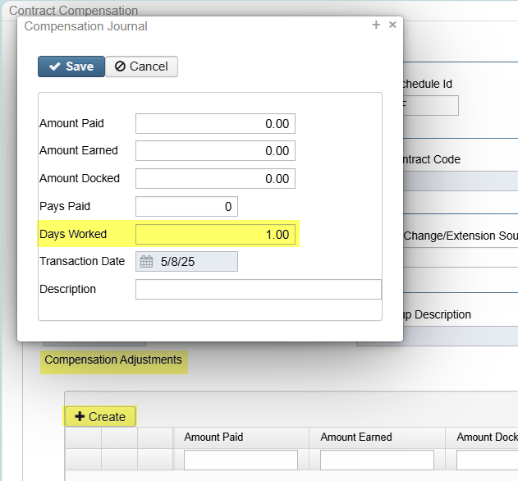
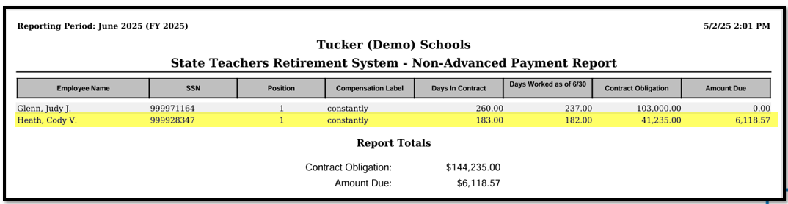
STRS Advance
Advance Positions Report ctd.
  If an employee is on the Non-Advanced Report and needs to advance, go to the Compensation screen and use the Compensation Adjustment > Days Worked to adjust 'Days Worked as of 6/30'

Slide 36
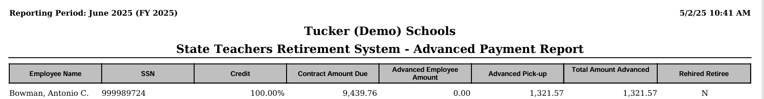
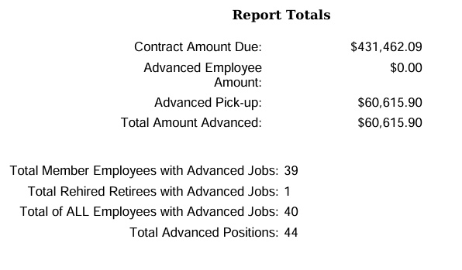
STRS Advance
Advanced Positions Report ctd.

Slide 37
STRS Advance
Sample Advanced Pick-up Calculation:
Obligation = $61,358.00
Pay Per Period = $2,359.92
Pays/pays paid = 26/22
23rd pay $2359.92 x 14% = $330.39
24th pay $2359.92 x 14% = $330.39
25Th pay $2359.92 x 14% = $330.39
26th pay
Obligation = $61,358.00
- Paid 25 pays = $58,998.00
Remaining = $2,360.00 x 14% = $330.40
Totaled Accrued wages calculated by STRS Advance:
330.39 + 330.39 + 330.39+ 330.40 = $1,321.57

Slide 38
STRS Advance
Non-Advanced Positions Report - Lists positions that will not advance
  (Please contact STRS for advice as to whether a position should be or not be advancing)
  Employee must have a Position with Retirement Code set to STRS and a Position must have a Job Status of Active or Inactive
  The Position must have a Contract Compensation
  Employee must have a Contract Compensation with a date range that the falls within the current date
  The Compensation Pays Paid must be less than Pays In Contract
  The Compensation Contract Work Days must be greater than 0
  The Compensation Contract Days Worked does not equal Contract Work Days as of June 30 (determined by using work days from the job calendars)

Slide 39
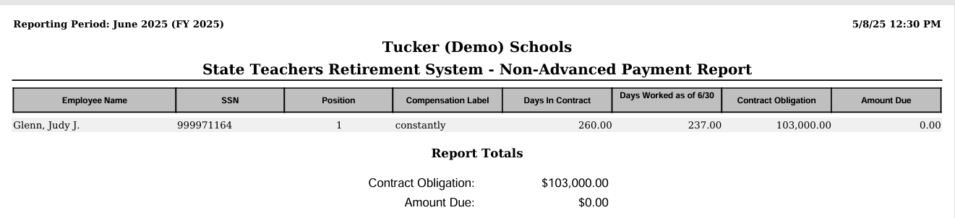
STRS Advance
Non-Advanced Positions Report ctd.

Slide 40
STRS Advance
For assistance with the STRS Advance process (including report errors and warnings), please refer to the STRS Advance Chapter in the SSDT USPS-R Web User Guide.
STRS Advance - USPS Documentation - SSDT Confluence Wiki (atlassian.net)

Slide 41
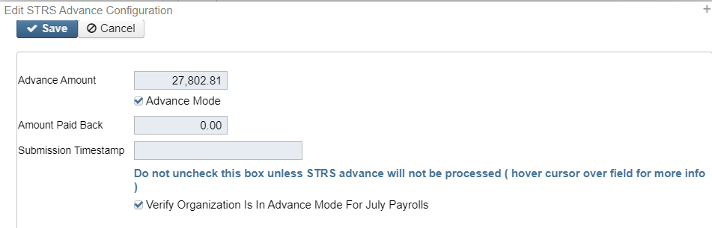
STRS Advance
Once the STRS Advance Reports have been verified and balanced, print final copies of all reports (if desired)
Create the STRS Advance Submission file
  Reports > STRS Reporting > STRS Advance > Generate Submission File
    Checks the STRS Advance checkbox on the Compensations advancing
    Sets the System > Configuration > STRS Advance Configuration fields

Slide 42
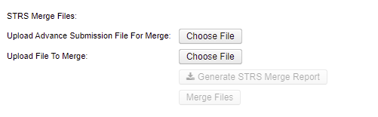
STRS Advance
    continued
      Creates STRSADYY06.TXT file
    Submit STRSADYY06.TXT file to STRS
      If a third party file needs to be included with your STRSADYY06.TXT file:
        Use Reports > STRS Reports > STRS Advance > STRS Merge Files option
STRSAD.YY06.TXT File from Redesign
Third Party File

Slide 43
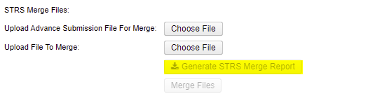
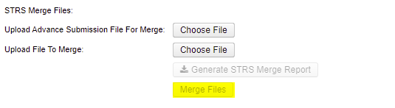
STRS Advance
      Click Generate the STRS Merge Report for verification
      Once STRS Merge Report is verified, click Merge Files

Slide 44


STRS Advance
      Go to Upload Submission File>Click Choose File>Browse to locate STRSADMERGED.TXT file
      Click Submit Uploaded File to STRS

Slide 45
STRS Advance
    If there is no third party file that needs to be included with your STRSADYY06.TXT file:
      Go to Upload Submission File>Click Choose File>Browse to locate STRSADYY06.TXT file
      Click Submit Uploaded File to STRS

Slide 46
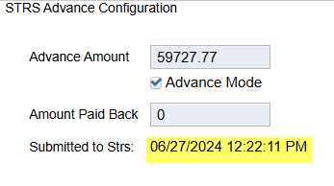
STRS Advance
    Once the file is submitted, can verify System > Configuration > STRS Advance Configuration > Submission Timestamp.
Notes:
Make sure it’s updated to new year

Slide 47
STRS Advance
STRS Annual Report is due by the first Friday in August.
DEADLINE for 2025-
August 1, 2025

Slide 48
STRS Advance
    When the STRS Advance Submission file is created, the following STRS reports are created in the FY End report bundle found in Utilities > File Archive – YYYY - Fiscal Year Reports
        STRS Advance Fiscal Year-to-Date Report
        STRS Advance Positions Report
        STRS Non-Advance Positions Report
        STRS Employee Merge Report (If applicable)
        STRSADMERGED.TXT (If Applicable)
        STRSADYY06.TXT

Slide 49
Post Fiscal Year End
Close the June YYYY posting period
  Core>Posting Period>June YYYY

Slide 50
Post Fiscal Year End
    When the June posting period is closed, the following reports are created in the FY End report bundle found in Utilities > File Archive – YYYY - Fiscal Year Reports:
        Attendance Journal Report
        Benefit Obligation Report by Account Report
        Benefit Obligation Report by Employee Report
        Leave Balance Report
        Payment Transaction Status Report
        Earnings Register Report
        Wage Obligation Report by Account
        Wage Obligation Report by Employee

Slide 51
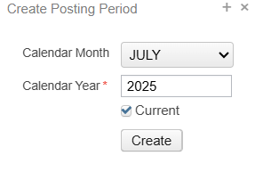
Post Fiscal Year End
Create the July XXXX posting period
  Core > Posting Period > Create
The first pay in July can now be processed!

Slide 52
Post Fiscal Year End
The District Audit Job for AOS that has already been scheduled to run annually by ACCESS in your USPS instance
        When this job runs, it will generate reports for the PREVIOUS FISCAL YEAR based on the current period which is why we ask that all districts be closed by July 25, 2024
        When the Audit Job runs, it will send reports to the File Archive Audit Reports
        section AND it will securely file transfer a copy of the reports directly to AOS.

Slide 53

Post Fiscal Year End -
STRS Advance
Items to Consider While in the STRS Advance:
  Regular and Irregular Pay Types cannot be used
  Dock (if not included prior to closing), Retro, Termination, and Pay off accrued wages can affect STRS Advance balancing
  Modifying the number of Pays Paid can affect STRS Advance balancing
  During the payroll process, the FYTD amounts on the 450, 591, and 691 payroll items will list both the advance amounts and New Earnings
  The Pay Report lists the advance amount processed for that pay

Slide 54
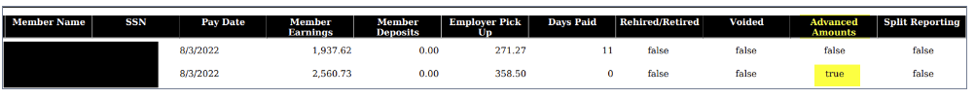
ADD SSDT SLIDE 54
Post Fiscal Year End -
STRS Advance
After the first pay in Advance Mode, the STRS Per Pay Report, will show if employees are in Advance.

Slide 55

Post Fiscal Year End -
STRS Advance
As summer pays are processed, System > Configuration > STRS Advance Configuration will update
  Amount Paid Back will increase
After all summer pays are complete, verify the STRS Advance balanced
  If the Amount Paid Back is equal or greater than the Advance Amount, then the district will no longer be in the advance and the Advance Mode flag will be unchecked
    When the Advance Mode flag is unchecked, the Amount Paid Back will be zero

Slide 56
Questions?

